Slide 1

Programming
By :Heba Hanandeh
ID: 18110060 Instructor:Dr.Jalal Kiswani

Slide 2

Introduction:
Initially I was selected as a programmer for the Ministry of Finance with the aim of automating paperwork they have, knowing that paperwork has many problems such as lost paperwork and the difficulty of entering and saving data for employees, here it came to me to solve these problems according to the requirements of the ministry and its needs.

Slide 3

requirements:
1) The screen for entering the employee number and the password in order to enter it into the system is called (log in).
2) A main screen of the system contains the titles of four screens, such as reports, my information, complaints& suggestions and the last holidays called (Main page).
3) Screen showing employee information in an apparent form such as name, job number, phone number, address and job title after entering a screen log in it is displayed and contains an option or title for an edit screen called (My Info)
4) The employee information editing screen allows the employee to change his phone number and address only, knowing that the job number does not change called (Edit My Info)
5) Take leave screen informing the employee to specify their type, name, reason and send them to a file that will be formed after filling in the employee information to request a leave called a vacation
6) A reports screen contains two types, the first is monthly, enables the employee to fill in data, display the monthly reports, and the second type annually has the same function.
7) The data filling screen monthly contains determination of the month, spending and earning and then save in another screen when press on view report ( 8 monthly report)
9) The data filling screen Yearly called data Fill data contains determination of the month, spending and earning and then save in another screen when press on view report (10 yearly report) 11) insert data called monthly /yearly reports

Slide 4

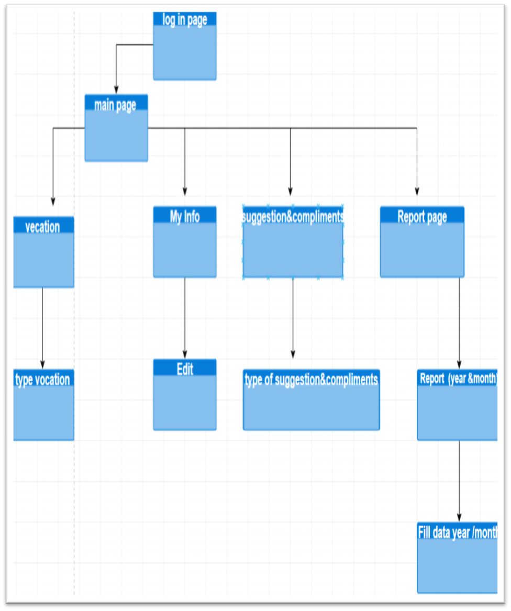
Sitemap

Slide 5

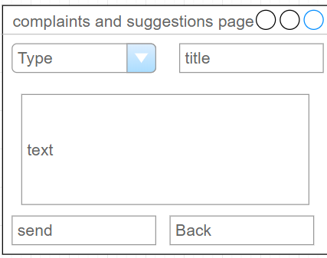
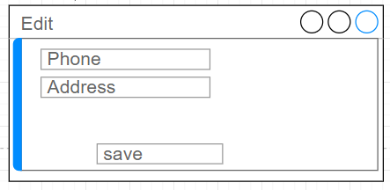
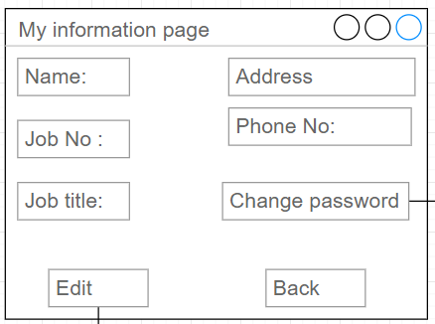
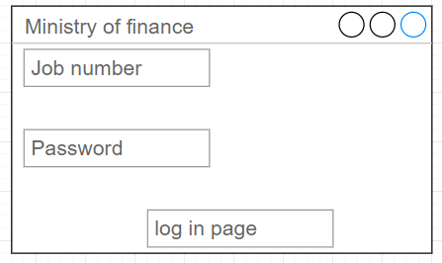
mockups

Slide 6
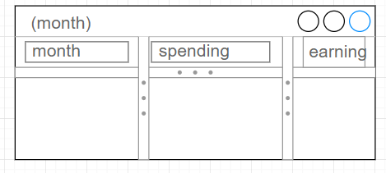

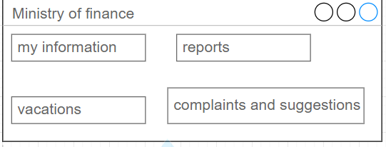
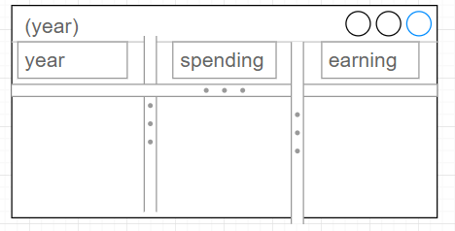
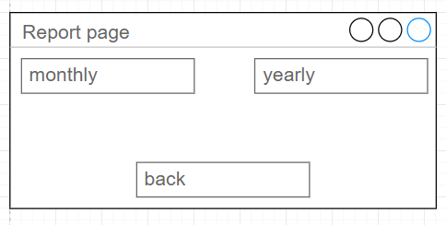

Slide 7
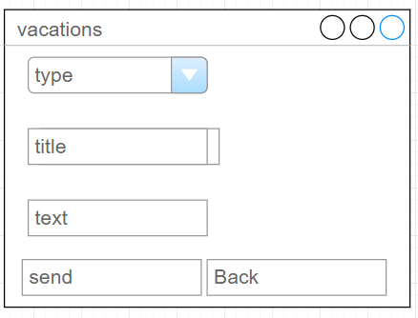
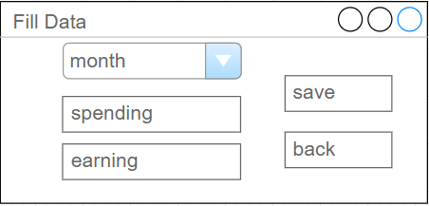
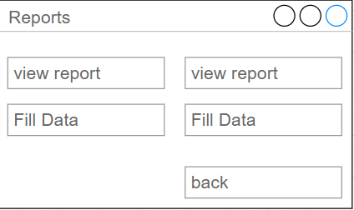
mockups

Slide 8
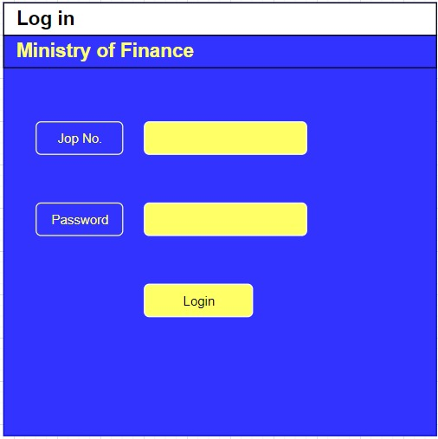

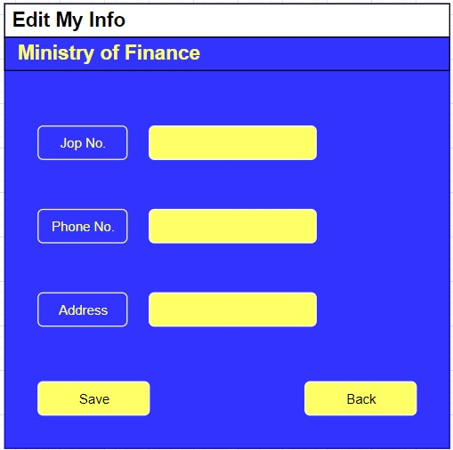
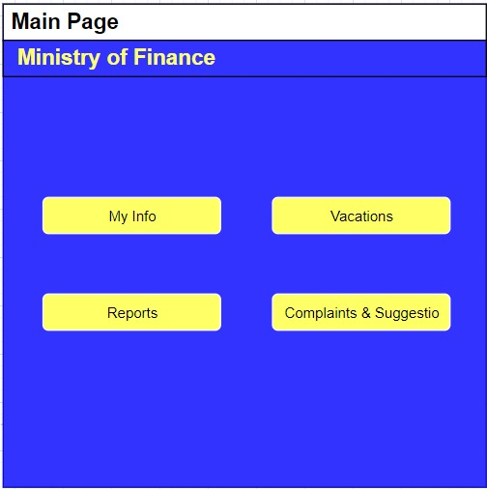
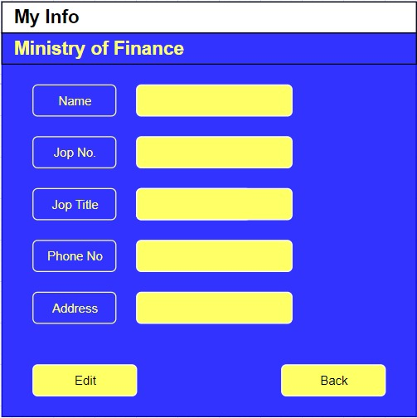
Wierframe

Slide 9
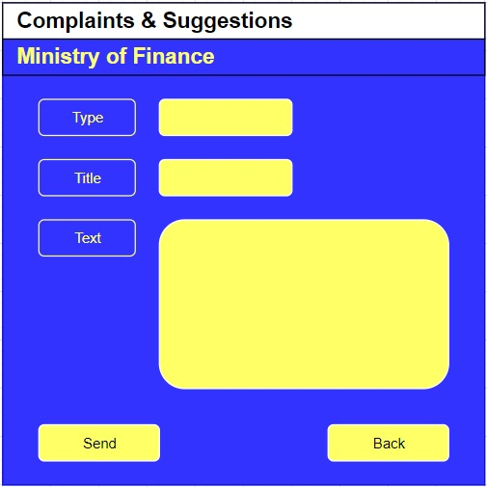
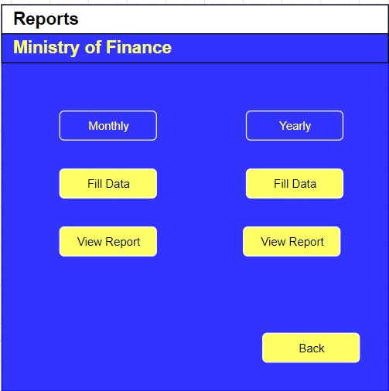
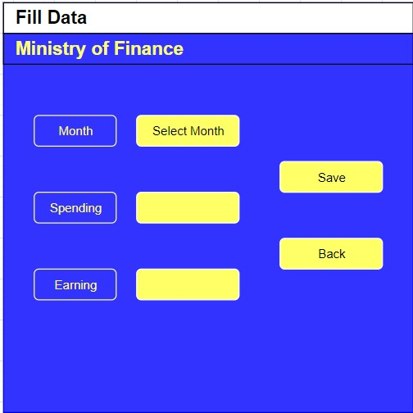
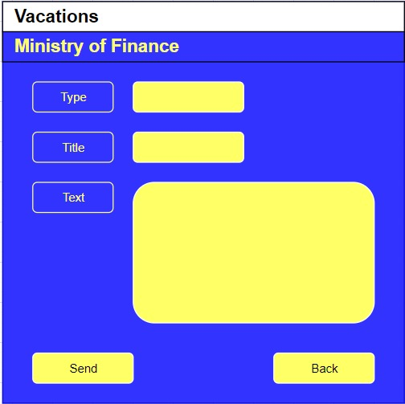
Wireframe

Slide 10
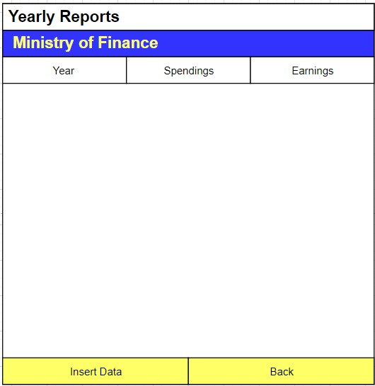
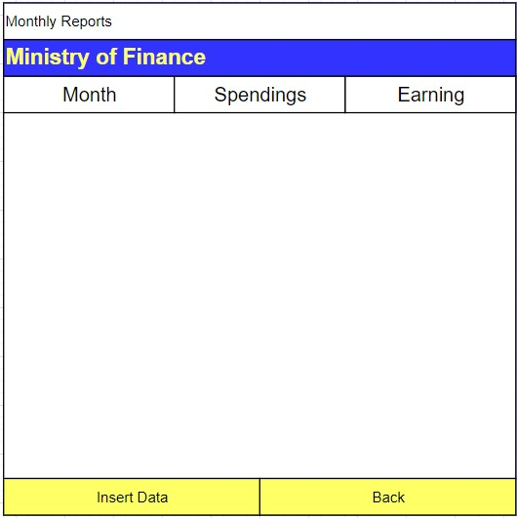
wireframe

Slide 11
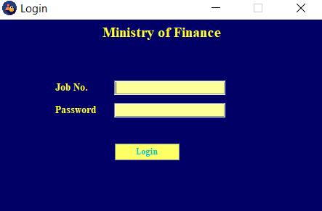
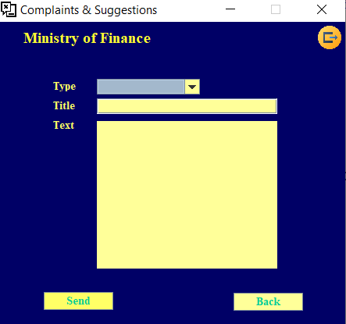
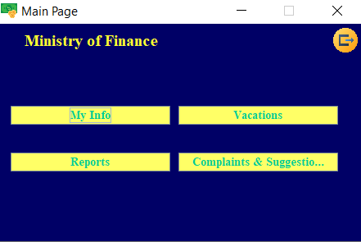
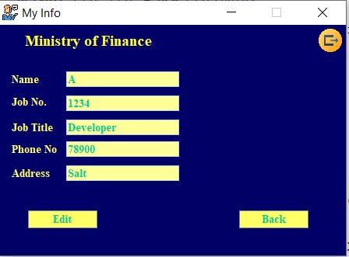
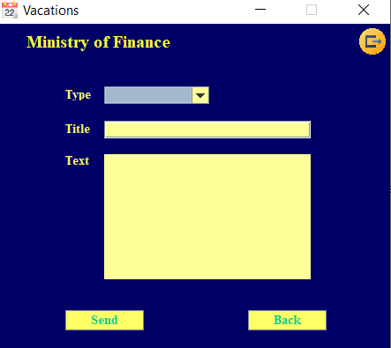
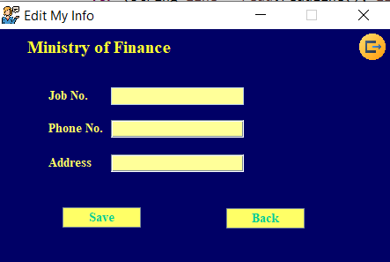
Actually interfaces

Slide 12
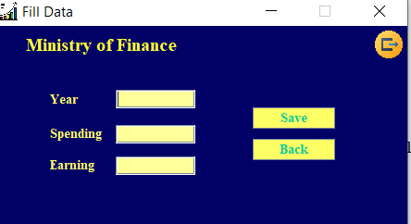
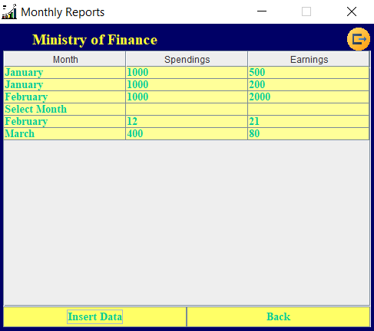
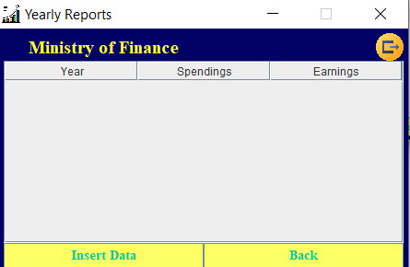
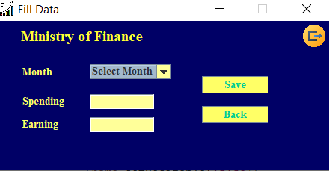
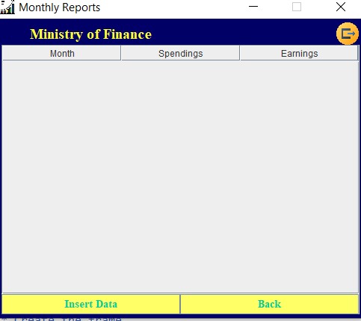
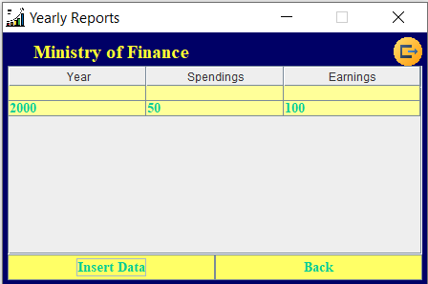
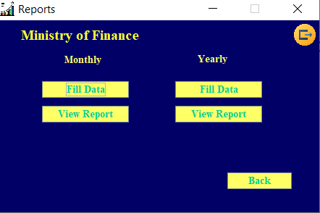
Actually interfaces

Slide 13
debugging
Because debugging is a reactive process, it’s not a good way to improving security.
Debugging permits you to run a program interactively while watching the supply code and the variables all through the execution.
A breakpoint inside the source code specifies in which the execution of this system should forestall all through debugging. As soon as the program is stopped, you can look at variables, alternate their content, and so forth.
To stop the execution, if a discipline is read or modified, you may specify watchpoints.
Eclipse permits you to begin a Java program with the basic Debug mode.

Slide 14



Test Plan
Made 15 Interface
Read from file
Write on file
Connect them together
Move and link
A location in the middle of the screen
Site map, Mockups-Wireframe

Slide 15
Reference
1) Anon, (2020). [online] Available at: https://en.wikipedia.org/wiki/The_Standard_Code_of_Parliamentary_Procedure [Accessed 25 Jan. 2020].
2) Oracle.com. (2020). Code Conventions for the Java Programming Language: 8. White Space. [online] Available at: https://www.oracle.com/technetwork/java/javase/documentation/codeconventions-141388.html [Accessed 25 Jan. 2020].
3) www.javatpoint.com. (2020). Java Comments - Javatpoint. [online] Available at: https://www.javatpoint.com/java-comments [Accessed 25 Jan. 2020].
4) variables, G. and Eels, H. (2020). GUI - JFrame: declaring variables. [online] Stack Overflow. Available at: https://stackoverflow.com/questions/21391750/gui-jframe-declaring-variables [Accessed 25 Jan. 2020].
5) EDUCBA. (2020). What is Debugging? | Different Process, Tools and Strategies of Debugging. [online] Available at: https://www.educba.com/what-is-debugging/ [Accessed 25 Jan. 2020].
6) SitePoint. (2020). Why You Need Coding Standards — SitePoint. [online] Available at: https://www.sitepoint.com/coding-standards/ [Accessed 25 Jan. 2020].
7) Expert Wannabe. (2020). Advantages and Disadvantages of Using IDE. [online] Available at: https://salfarisi25.wordpress.com/2010/12/22/advantage-and-disadvantage-of-using-ide/ [Accessed 25 Jan. 2020].

